Slide 1
Using NLP on Reddit Posts to Predict BTC Price
Joseph Hardin
MS-DS Student at the University of Colorado-Boulder
Unsupervised Machine Learning

Slide 2
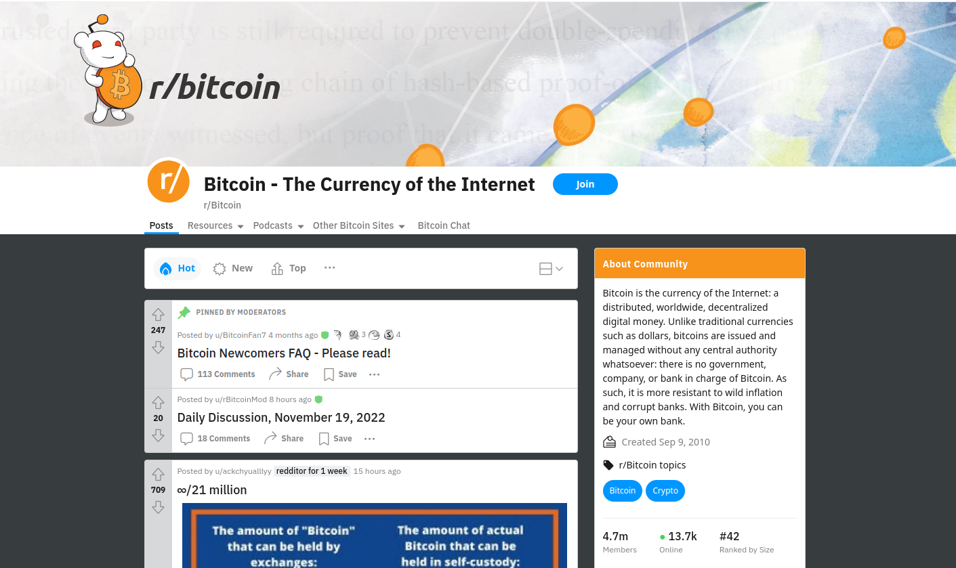
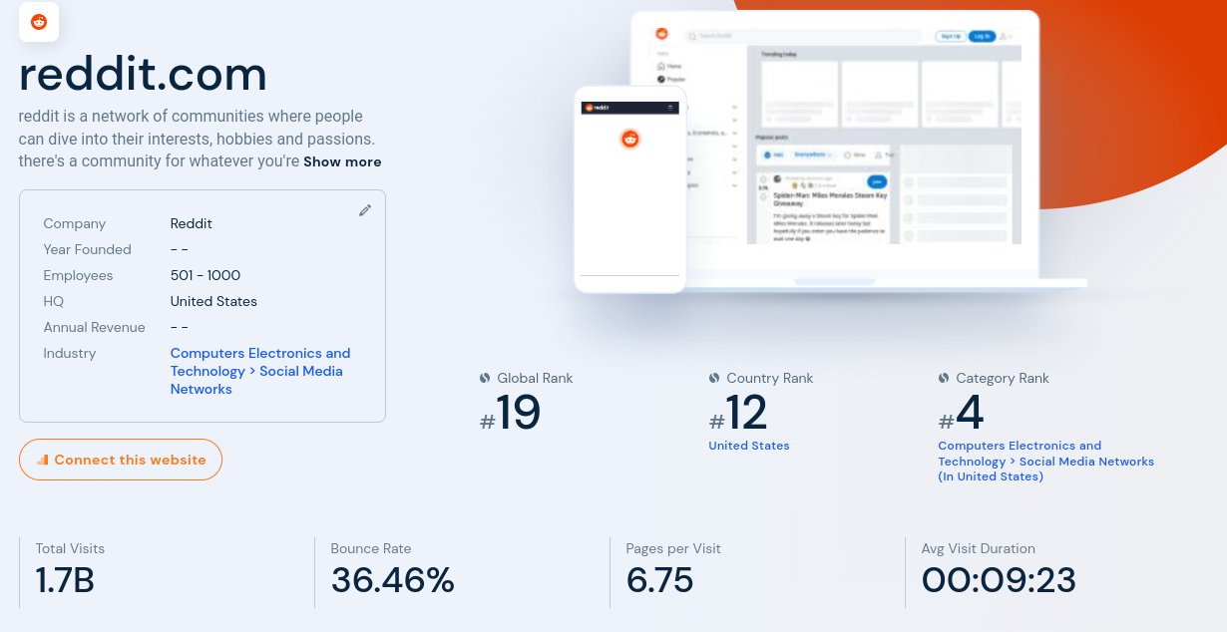
What is Reddit?
Hugely popular website
Broken into sections by topic (subreddit)
The main subreddit about Bitcoin is www.reddit.com/r/Bitcoin
Biases include: English Speaking, USA, Male

Slide 3
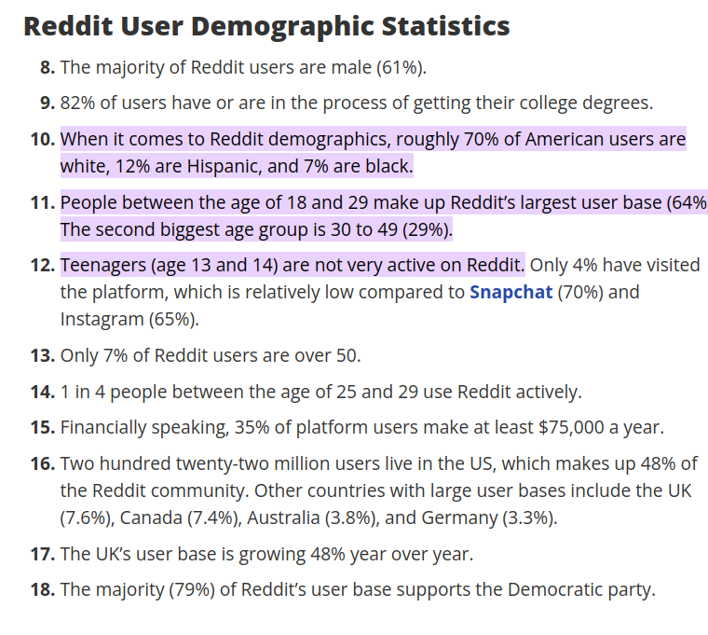
Potential Sources of Bias
Source: https://thrivemyway.com/reddit-statistics/#:~:text=When%20it%20comes%20to%20Reddit,not%20very%20active%20on%20Reddit

Slide 4

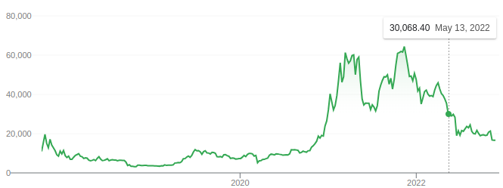
Bitcoin (BTC)

Slide 5
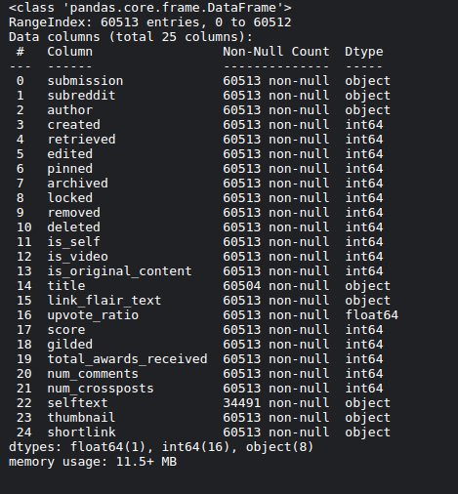
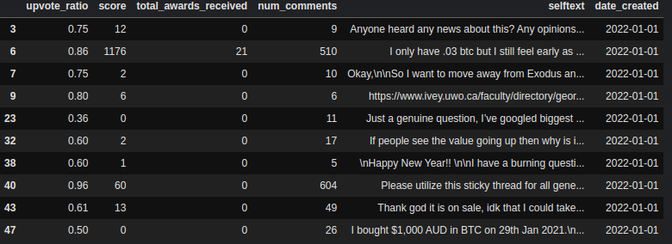
Reddit Data Cleaning
Keep only Posts with ‘selftext’ longer than 20 characters
Reformat and rename ‘created’ to the clearer ‘date_created’. Change from timestamp to date YYYY-MM-DD
Kept Metadata related to engagement: upvote ratio, score, total awards received , total number of comments

Slide 6
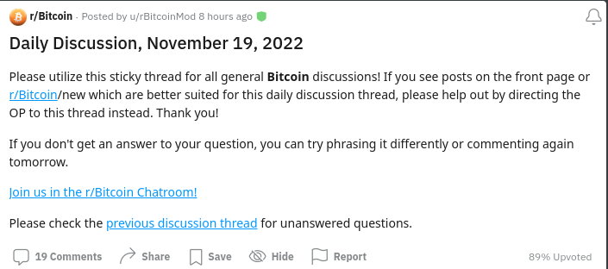
Final Cleaning For Reddit Data

Slide 7
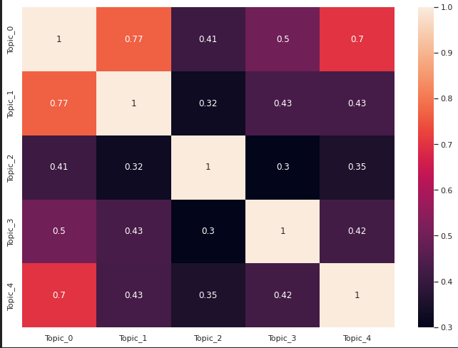
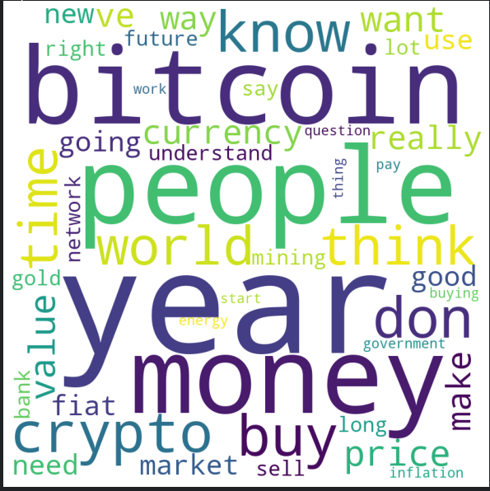
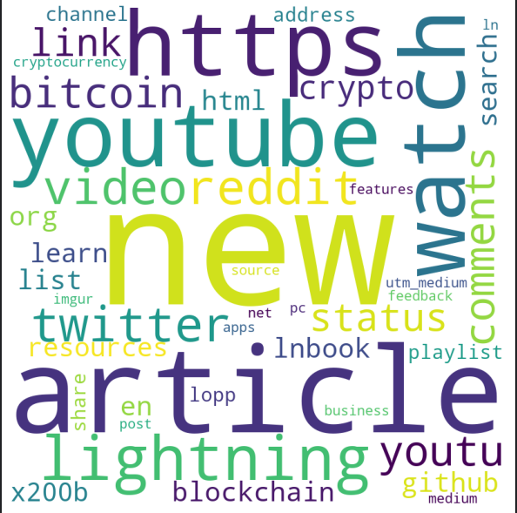
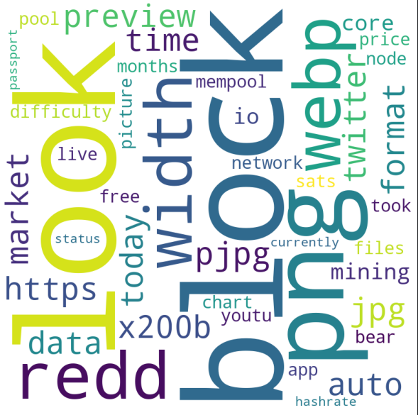
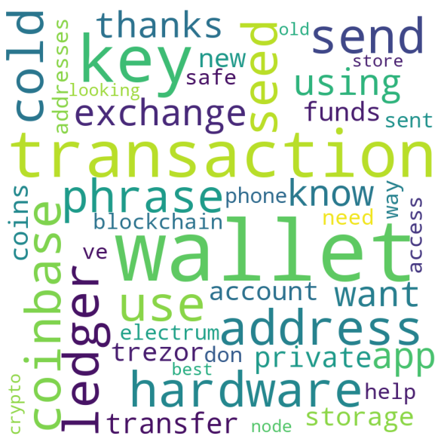
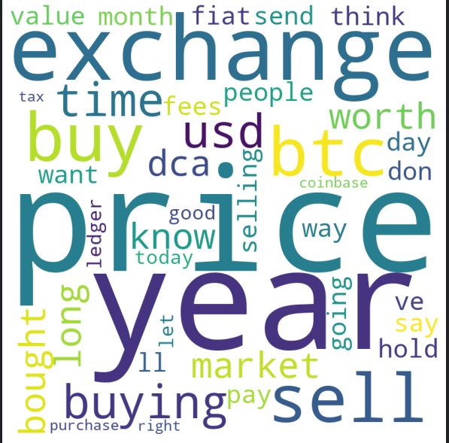
NLP on Reddit Posts
Reddit ‘Selftext’ Posts
SKLearns Tokenization. Hyper parameters: 2000 words/features, stop words ‘english’
SKLearns Nonnegative Matrix Factorization. Hyper parameters: 5 topics, alpha= .1, l1 ratio = .5
Topic 0
Topic 1
Topic 2
Topic 3
Topic 4
Correlation Matrix

Slide 8
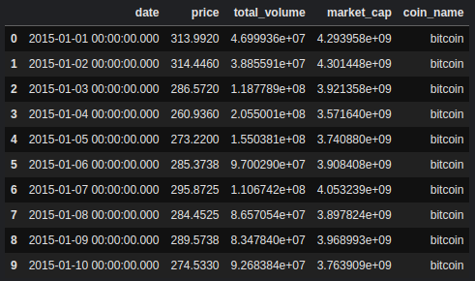
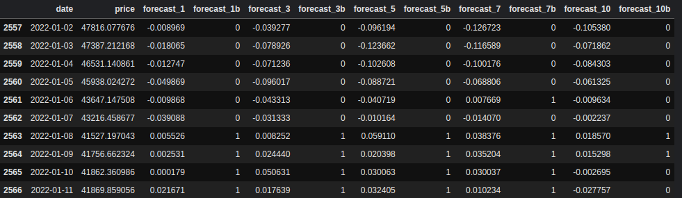
BTC Price Data Cleaning and Munging
Keep only price and date columns
Drop time from date info, leaving only date for consistency with Reddit Data
Restrict price data to the same timeframe as Reddit data (year =2022)
Calculate the percent [0..1] change in price over the next 1,3,5,7,10 days. Call these features forecast_x. Capture sign as binary in adjacent column forecast_xb

Slide 9
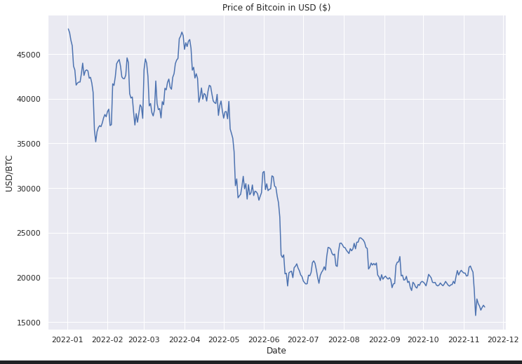
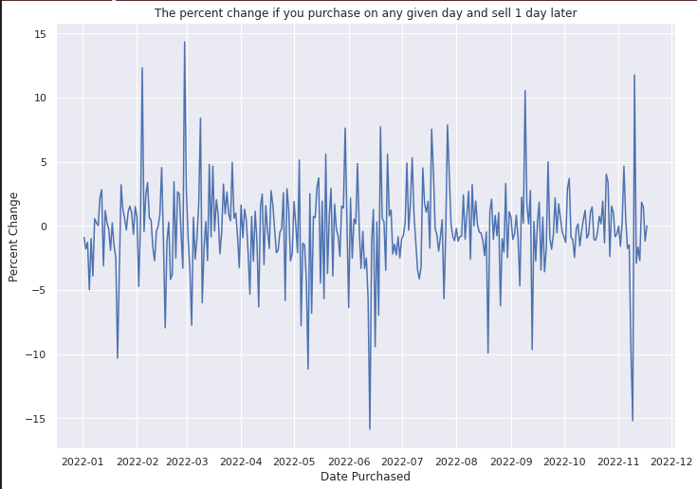
Exploring Patterns between Reddit data and price
Poor year on average for bitcoin, however still money to be made if you can predict daily deltas

Slide 10
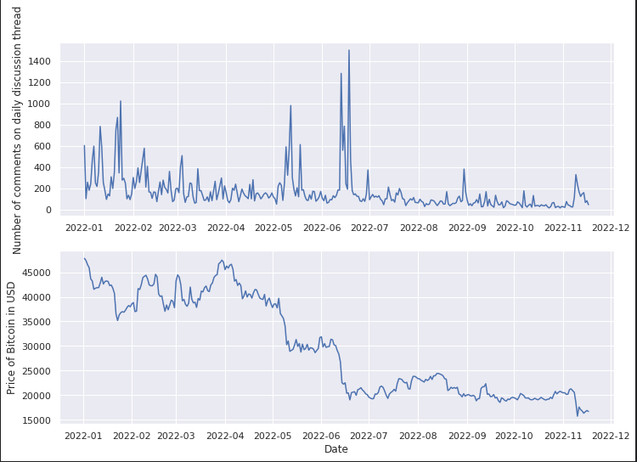
Exploring Patterns between Reddit data and price: Metadata

Slide 11
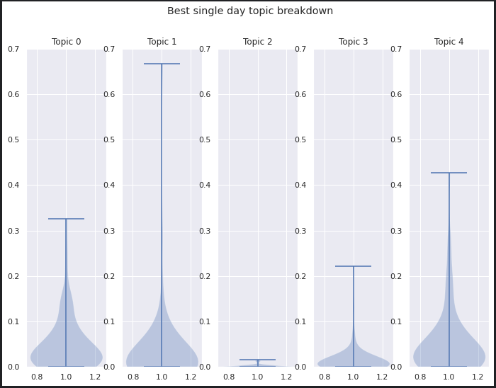
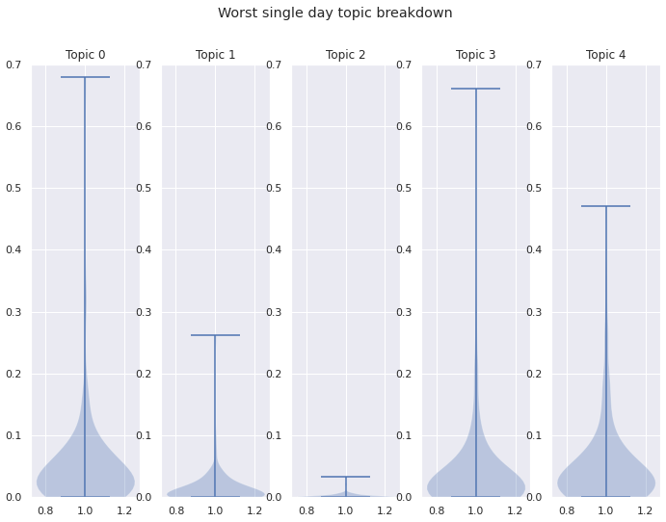
Exploring Patterns between Reddit data and price: Text data
Best Day to invest: 2022-02-28. Will increase 14.3% by 2022-03-01 (next day)
Below is the violin plots of the topics of the 67 post that met criteria on 2022-02-28
Worst Day to invest: 2022-06-13. Will decrease 15.8% by 2022-06-14 (next day)
Below is the violin plots of the topics of the 120 post that met criteria on 2022-06-13

Slide 12
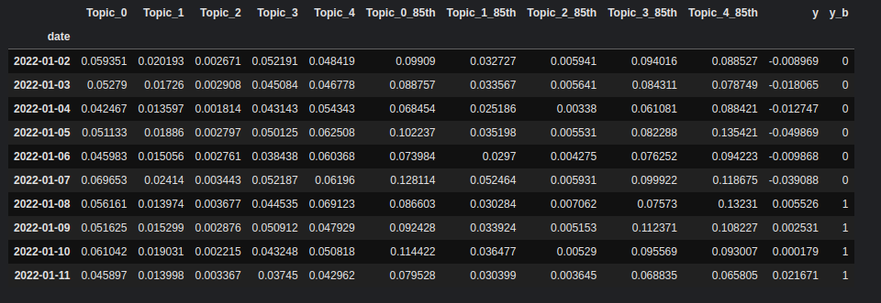
Final Prep of Data for KNN

Slide 13
K-Nearest Neighbor: Regression and Classification
#Neighbors | Classification: Accuracy | Classification:True Positive | Classification :False Negative | Regression :R^2
1 | 0.498 | 61 | 52 | -1.07
2 | 0.485 | 92 | 86 | -0.65
3 | 0.481 | 60 | 55 | -0.54
4 | 0.498 | 86 | 77 | -0.52
5 | 0.456 | 58 | 59 | -0.40
6 | 0.519 | 86 | 72 | -0.30
7 | 0.498 | 63 | 54 | -0.30
8 | 0.527 | 83 | 67 | -0.27
9 | 0.527 | 66 | 50 | -0.26

